Slide 1
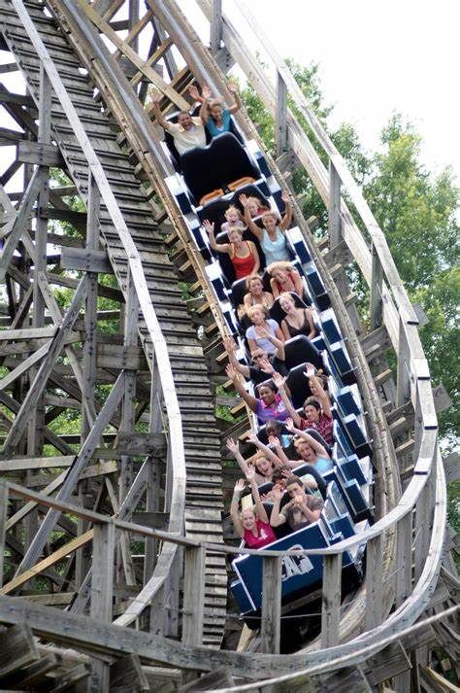
Energy

Slide 2

Warm-up
What is Energy? Where do you see energy?

Slide 3

What is Energy?
Energy is the ability to do work

Slide 4
Types of Energy
In science, there are many types of energy:
  Kinetic
  Potential
  Thermal
  Electrical
  Biological
  Chemical
  Radiant
  Sound
  Nuclear
  Gravitational
This is not all of them and we’ll focus on only a few of these

Slide 5
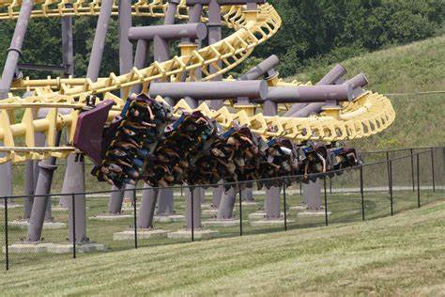
Kinetic Energy
Kinetic Energy is the energy of an object which is moving

Slide 6
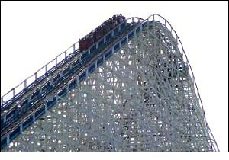
Potential Energy
Potential Energy is energy an object has due to gravity or stored physical energy like a spring.

Slide 7
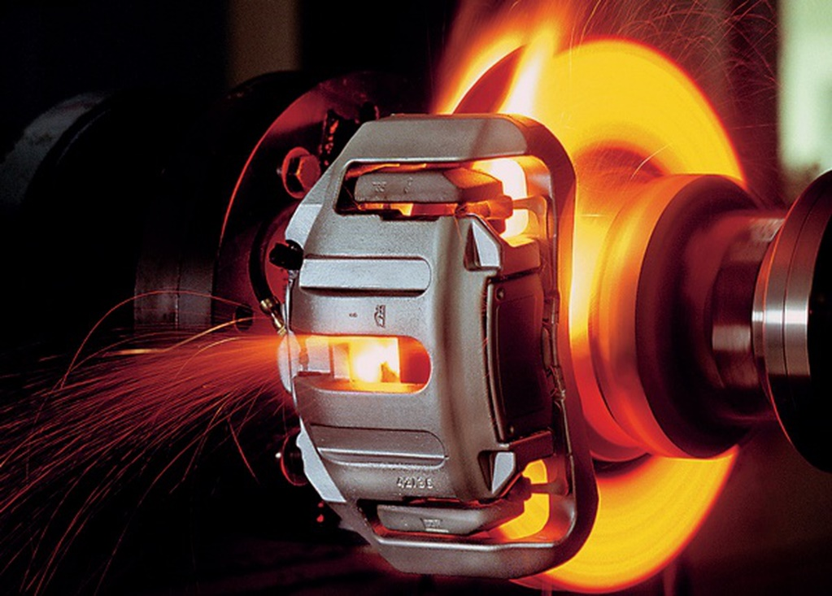
Thermal Energy
Thermal (heat) energy is energy caused by the movement of molecules in the system.

Slide 8
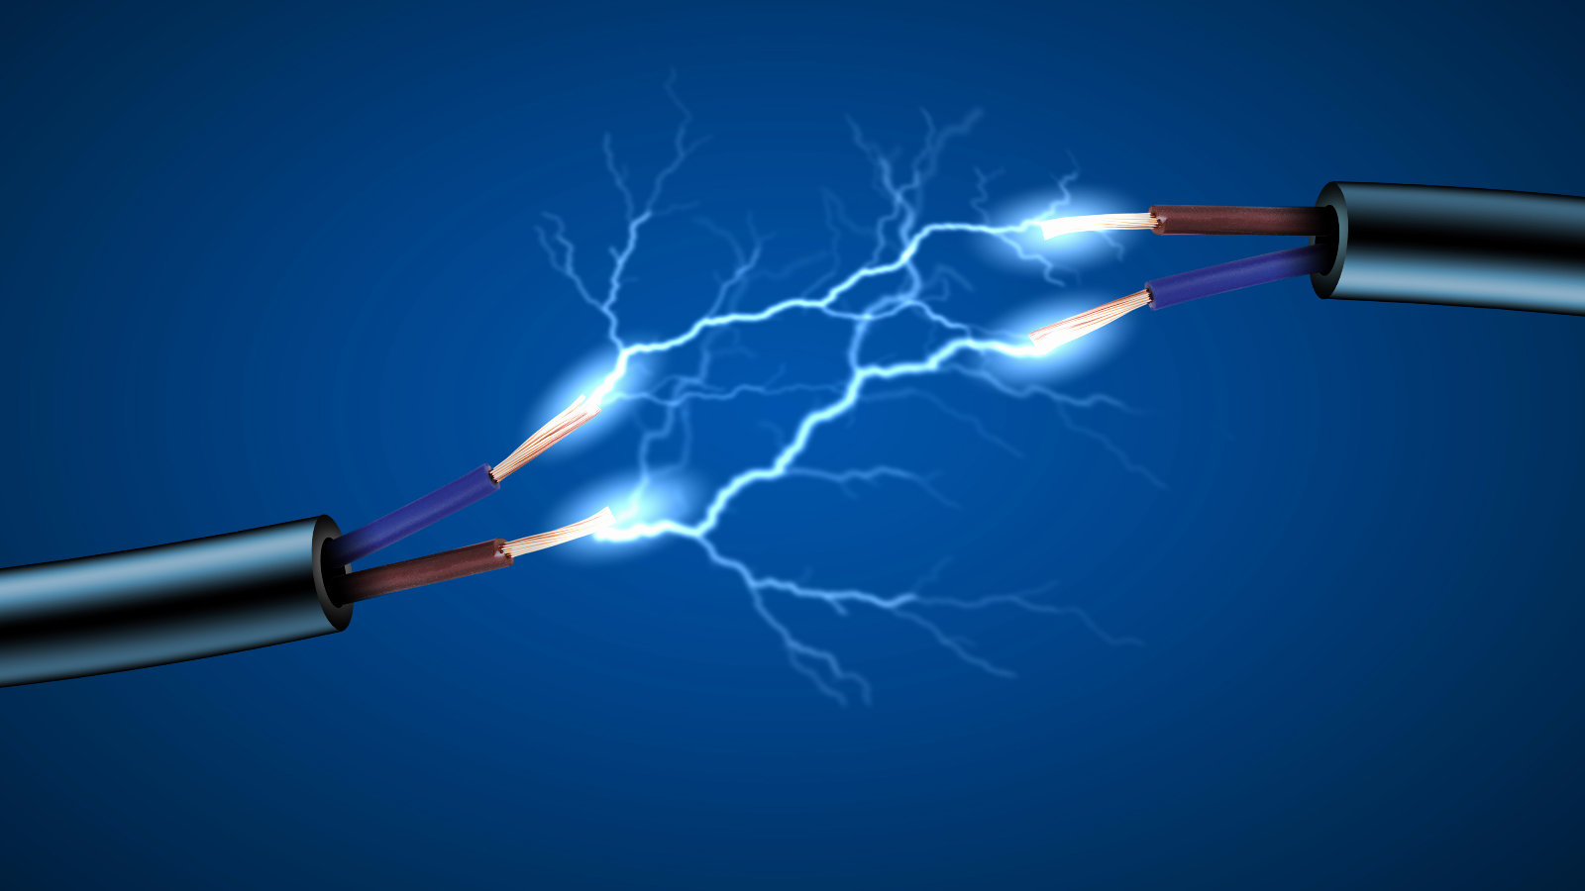
Electrical Energy
Electrical Energy is created from a flow of electrical charge

Slide 9
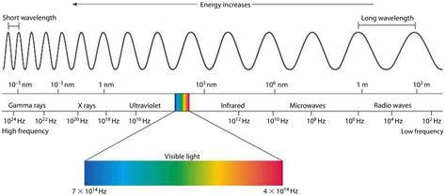
Radiant Energy
Radiant (Electromagnetic) Energy is energy transferred from electromagnetic radiation (Light, X-Rays, Microwaves, etc.)

Slide 10
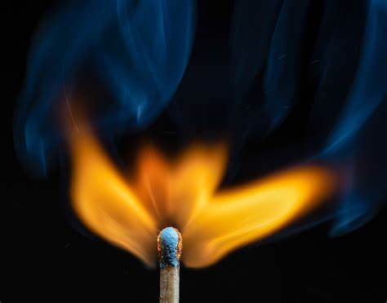
Chemical Energy
Chemical Energy is potential energy stored in chemical bonds

Slide 11
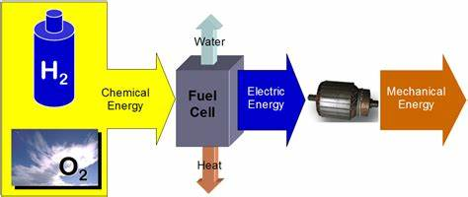
Energy Conversion
When a system changes one form of energy into another. Example of a Hydrogen fueled car engine

Slide 12
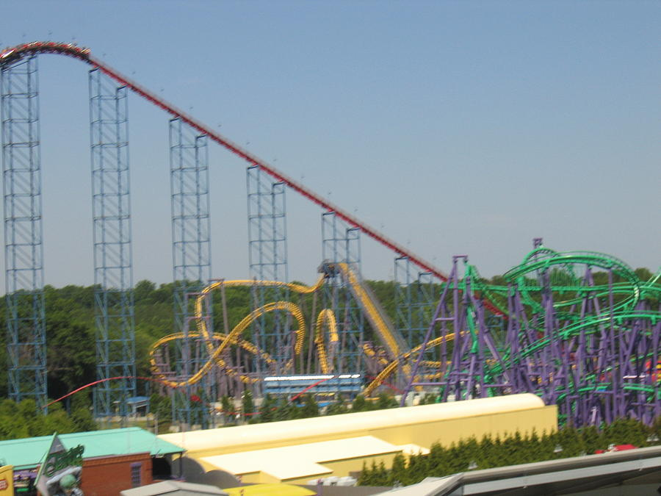
Discussion
How many energy conversions can you think of that are happening throughout a roller coaster?

Slide 13
Discussion
Station brakes open which allows the train to move turning potential energy (gravity) into kinetic energy
Lift hill raises the train turning kinetic energy into potential energy (gravity)
Train leaves hill turning potential energy (gravity) into kinetic energy (and the process repeats over and over throughout the length of track)
The motor moving the lift hill chain converts electrical energy into kinetic energy
The brakes stopping the train use friction which converts kinetic energy into thermal energy. As the brakes cool, that thermal energy converts to radiant energy
There are many more and some types of rollercoaster use different ways of gaining energy

Slide 14
Non-Renewable

Slide 15
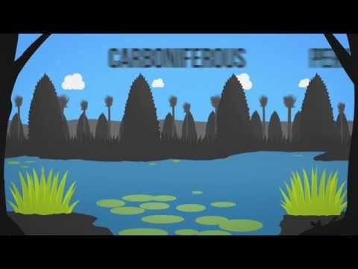
Fossil Fuels 101 Video
https://www.youtube.com/watch?v=zaXBVYr9Ij0
Notes:
https://www.youtube.com/watch?v=zaXBVYr9Ij0

Slide 16
What are fossil fuels? (2:42 mins)
Write the questions and then answer during video
https://www.youtube.com/watch?v=zaXBVYr9Ij0
1. What are the 3 main types of fossil fuels?
2. What are some ways we use fossil fuels?
3. What are some issues with fossil fuels?
Coal, Natural Gas, Oil
Energy source- electricity, transport fuels, plastics, cosmetics, medicines
Can be expensive, non-renewable (cannot be replenished in human lifetime), additional safety and environmental concerns, emit CO2 (causing greenhouse effect)

Slide 17
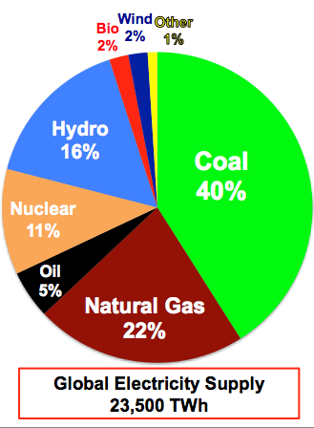
What is running the world?
What are examples of clean power?
Hydroelectric, Solar, Geothermal, Wind
Why can’t we just completely switch to clean energy in the next several years?
    The global economy would crash – too many countries rely on the MONEY that fossil fuels supply.
    THOUSANDS of people would lose their jobs.

Slide 18
Warm-up
what is the difference between
renewable energy and clean energy ¯\_(ツ)_/¯
Renewable energy is derived from sources that can naturally replenish themselves
wind and sun are the two most obvious examples 💨 ☀️
while clean energy encompasses all zero-carbon energy sources ☢️

Slide 19
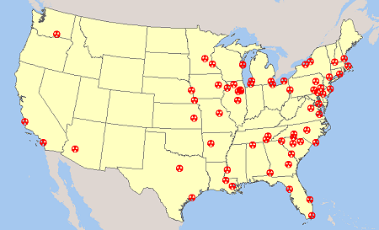
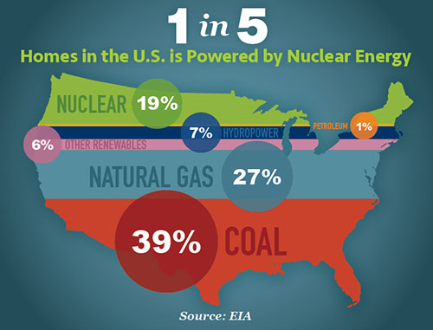
Nuclear Energy
Non-Renewable, but “clean”
Energy produced though the colliding of radioactive atoms
19% of homes in the US is powered by nuclear power
Why not invest more in nuclear energy?
WHAT’S THE RISK?
  Radiation
  Reactor accidents
  Radioactive Waste
  Targets for Terrorist Acts/War

Slide 20
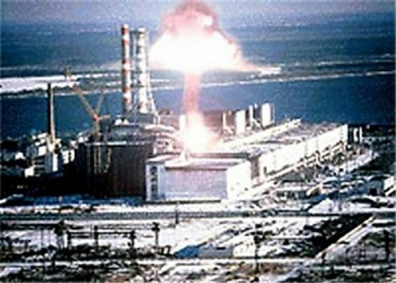
NUCLEAR DISASTERS
In the entire history of nuclear energy production, there have only been 3 major disasters – Three Mile Island, Fukushima, and Chernobyl.
In the past 25 years, there have been over 10 major disasters with fossil fuel energy – the largest of which was the BP oil spill.

Slide 21
Types of Renewable Energy
Solar
Geothermal
Hydroelectric
Wind
Biomass/Biofuel

Slide 22
Solar Energy
Energy created through Sunlight
What companies do you know that provide solar energy here in Maryland?
SmartFlower: An intelligent Solar Panel System for homes
Notes:
https://www.youtube.com/watch?v=WuZFG1R0hyY

Slide 23
SOLAR ENERGY PROBLEM SOLVED?
click here to see a video on Solar Freakin Roadways
Is this realistic? What might be some problems? Any suggestions?

Slide 24
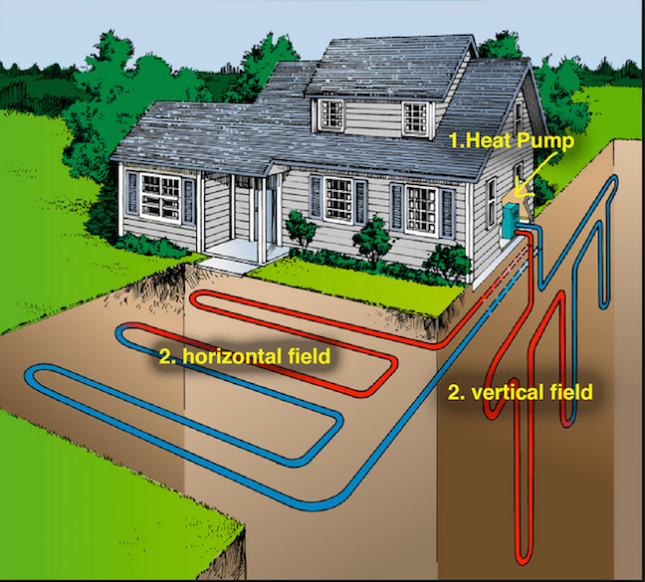
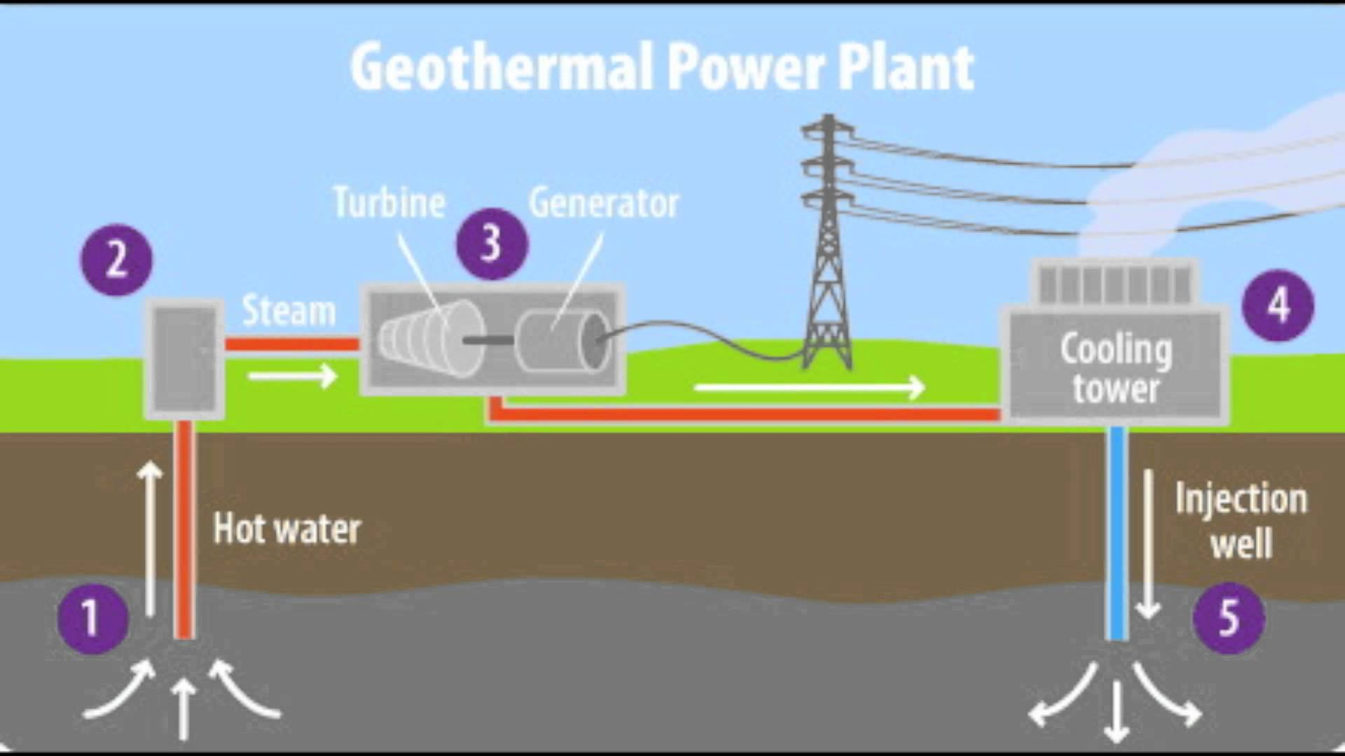
Geothermal Energy
Geo meaning Earth and Thermal meaning Heat
Heat Energy that comes from the Earth
May also be cooling from the ground as well.

Slide 25
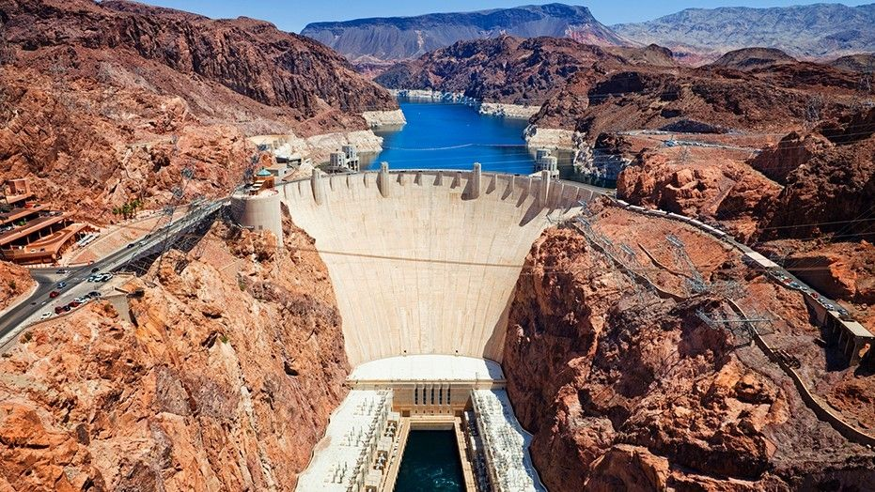
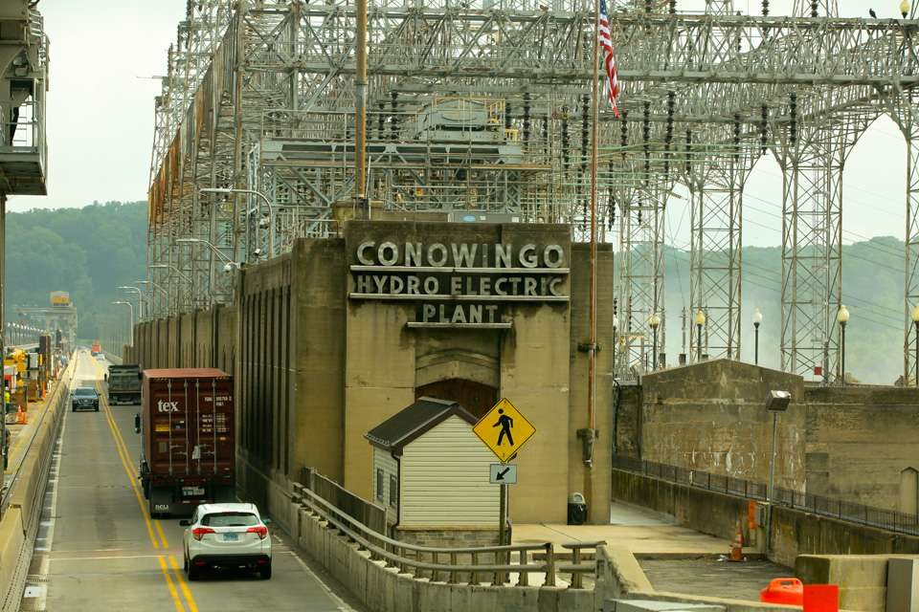
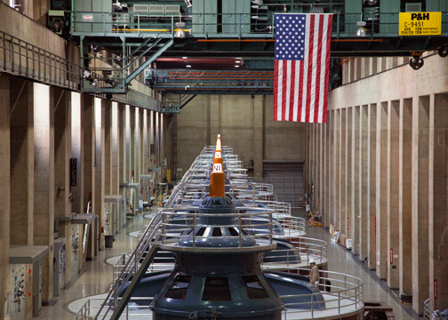
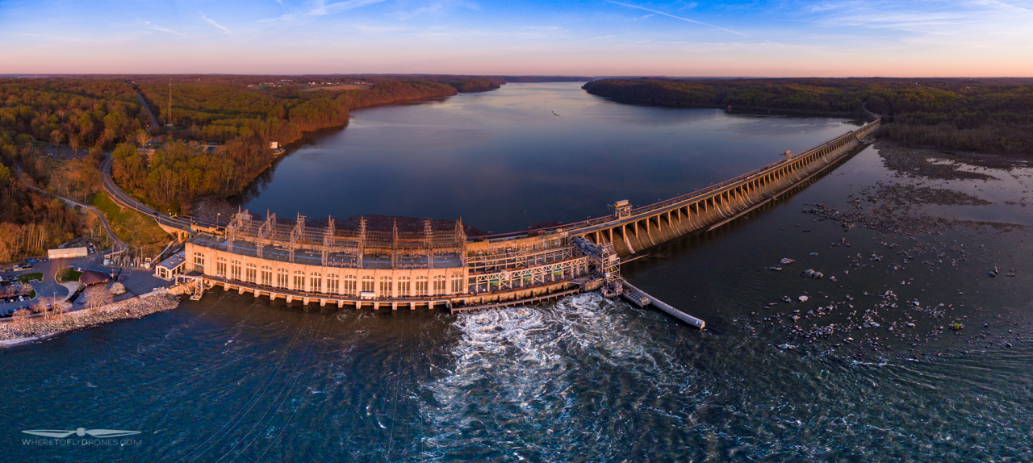
Hydroelectric
Ex: Hoover Dam, Arizona/Nevada and Conowingo Dam, Maryland
The generation of electricity using flowing water (typically from a reservoir held behind a dam or other barrier) to drive a turbine that powers a generator

Slide 26
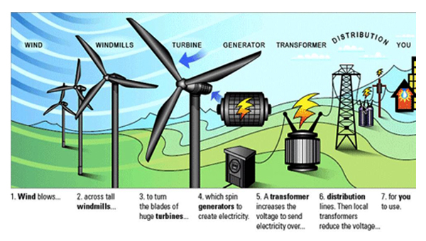
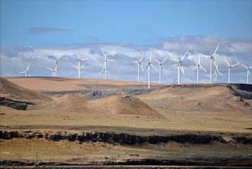
Wind
Wind energy (or wind power) describes the process by which wind is used to generate electricity. Wind turbines convert the kinetic energy in the wind into mechanical power. A generator can convert mechanical power into electricity

Slide 27
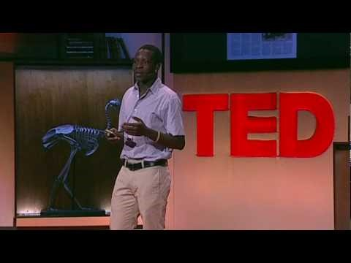
Boy who Harnessed the Wind
Notes:
Could be used as final project preview.

Slide 28
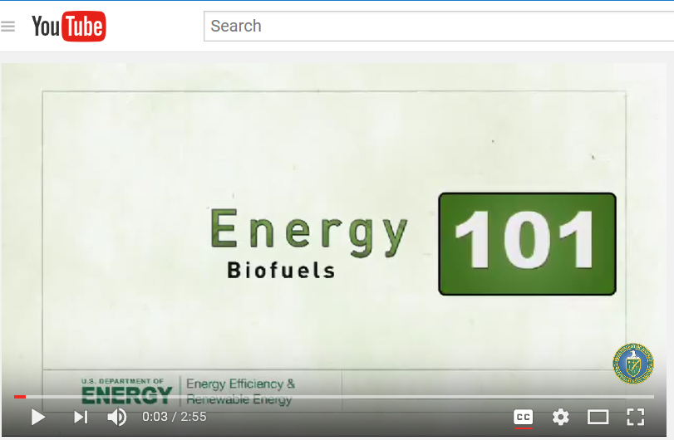
How are biofuels created?
click here to watch how biofuels are created

Slide 29
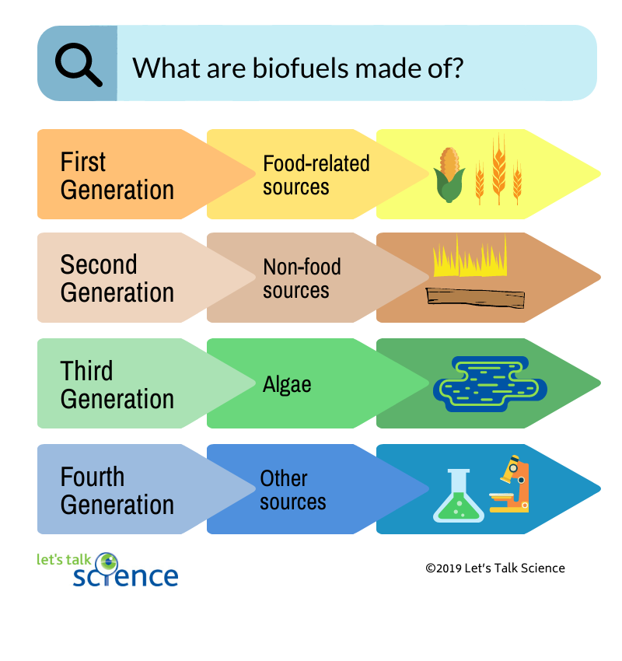


Biomass/Biofuel- Organic matter used as a fuel
The Secret to Better Biofuels May Lie In Panda Poop Video

Slide 30

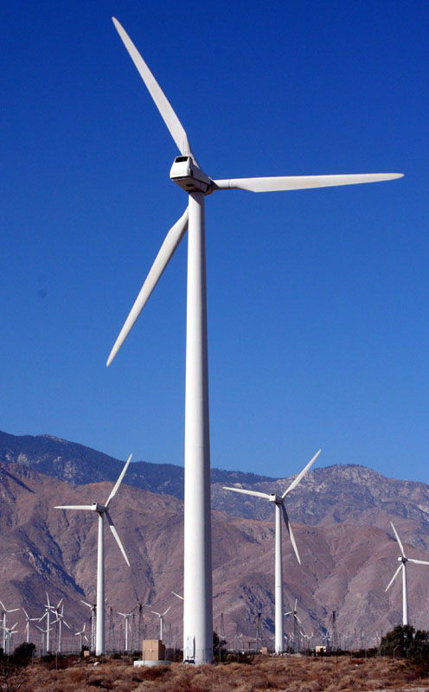
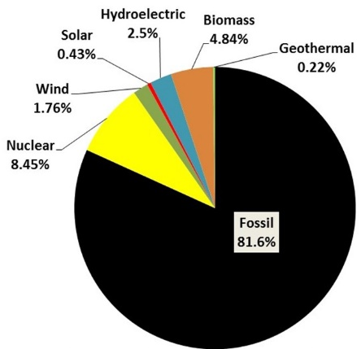
POSTER/ADVERTISEMENT PROJECT (optional)
Create a poster/advertisement promoting your choice of energy source.
  Coal, oil, natural gas, wind, solar, geothermal, biofuel, hydroelectric, nuclear…
Create a title
Create a catchy slogan
Write a short description explaining the benefits of your energy source.
Include a picture/graphic representing your energy source.
CONTEST: I will have a group for each energy source and we will rotate through the groups looking at each student’s work – using their work to write down facts about each energy type. We will also vote on the BEST poster. The most votes gets a prize!!!
WIND ENERGY
The environmental impact reduction will BLOW YOU AWAY!!!
One large windmill can generate enough energy to power 600 homes and would reduce carbon emissions by 824.2 billion tons each year.
Currently ONLY 1.7% of U.S. energy is produced from wind.

